Slide 1
Introduction to Web Development

Slide 2
World Wide Web
The World Wide Web (WWW) is a system of interconnected documents and resources, linked together through hyperlinks and URLs (Uniform Resource Locators).
It is a vast information space accessible over the Internet, allowing users to browse and navigate through webpages, images, videos, and other multimedia content.
Tim Berners-Lee, a British computer scientist, is credited with inventing the World Wide Web in 1989.

Slide 3
Importance of the Web in Modern Society
The Web plays a pivotal role in modern society, serving as a global platform for communication, collaboration, and information dissemination. Its significance extends across various domains:
Communication
Information Access
E-commerce
Entertainment
Social Interaction

Slide 4
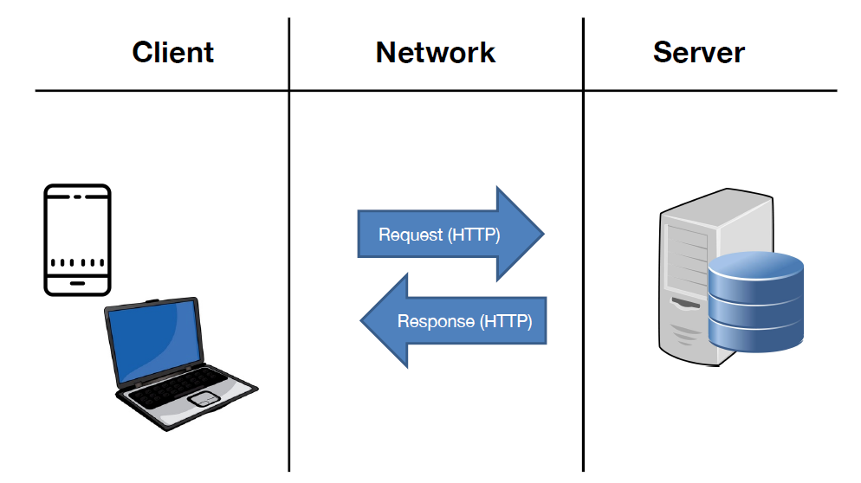
Key Components: Clients and Servers

Slide 5
Types of Web Developers
Front-End Developers
Back-End Developers
Full-Stack Developers

Slide 6
Requirements for web development
Project Requirements Gathering
Technology Stack
Design and User Experience (UX)
Content Management
Security Measures
Performance Optimization
Database Design and Management
Testing and Quality Assurance
Scalability
Documentation
Maintenance and Support

Slide 7
Process of Web Development
Planning Phase
Design Phase
Development Phase
Testing Phase
Deployment Phase

